Slide 1
Neural Networks

Slide 2
Review: Machine learning concepts
Three forms:
Supervised learning
The agent is given some input-output pairs and it learns a function that maps the input to the output.
Example: training a naïve Bayes classifier.
Unsupervised learning
The agent learns patterns in the input even though no explicit output or feedback is given.
Example: clustering
Reinforcement learning
The agent is given feedback (rewards) during the steps of a task and the agent learns a function from states to predicted rewards.

Slide 3
Supervised learning
Given a training set of N example input-output pairs:
(x₁, y₁), (x₂, y₂), ..., (x_{N}, y_{N})
Each y is generated by an unknown function y = f(x).
Goal: discover a function h that approximates the true function f.
h is called a hypothesis.
Machine learning algorithms conduct searches for the "best" f.
We can measure the accuracy of a hypothesis on a test set of examples that are distinct from the training set.
A hypothesis generalizes well if it correctly predicts examples from the test set (even though it has never seen them before).

Slide 4
Supervised learning

Slide 5
Supervised learning
Poor generalization is sometimes caused by overfitting: our hypothesis has learned the training set very well, but it has poor accuracy on the test set.
Analogous to "memorizing" the training set.
When the output y is one of a finite set of values (e.g., sunny/cloudy/rainy or true/false), the learning problem is called classification.
When the output is a number, the problem is called regression.
Yes, linear regression is a machine learning algorithm!

Slide 6
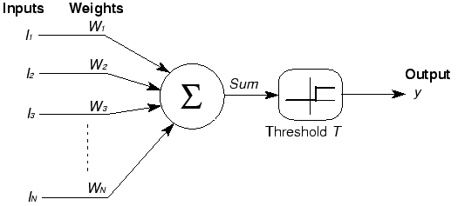
McCullough-Pitts neuron
1943: Warren McCullough and Walter Pitts, two electrical engineers, develop the first model of an artificial neuron, called threshold logical units.
Notes:
Drawbacks – only generates binary outputs, weights and thresholds are all identical for all neurons. No algorithm for learning or training.

Slide 7
Perceptron
1958: Frank Rosenblatt refined the McCullough-Pitts neuron into the perceptron.

Slide 8
NNs are composed of nodes or units connected by directed links (a graph structure).
Each unit receives a collection of numeral inputs (a₀, a₁, ...) and produces a numeral output (a_{j}).
A link from unit i to unit j has a weight w_{ij} associated with it.
Each unit has a dummy input (a₀) that is always set to 1.

Slide 9
Each unit j first computes a weighted sum of its inputs:
Then it applies an activation function g to this sum to produce the output:
Notes:
\text{\textsl{in}}_j = \sum_{i=0}^n w_{i,j}\cdot a_j
a_j = g(\text{\textsl{in}}_j )

Slide 10
The function g is typically either a hard threshold function or the logistic function:
Notes:
\text{\textsl{in}}_j = \sum_{i=0}^n w_{i,j}\cdot a_j
a_j = g(\text{\textsl{in}}_j )

Slide 11
Neural networks
Two basic types of networks.
Feed-forward: Links are only in one direction (DAG).
Recurrent: Allows outputs to feed back into inputs.
System may reach a steady state or may exhibit oscillations or chaotic behavior.
Feed-forward networks are usually arranged in layers, where each layer only receives input from the previous layer.
Single layer – all inputs connected directly to outputs
Multi-layer - one or more hidden layers of units in between input and output.

Slide 12
Single layer feed forward networks
One input layer (which is just the raw inputs).
One output layer (of perceptron units).
Example.

Slide 13
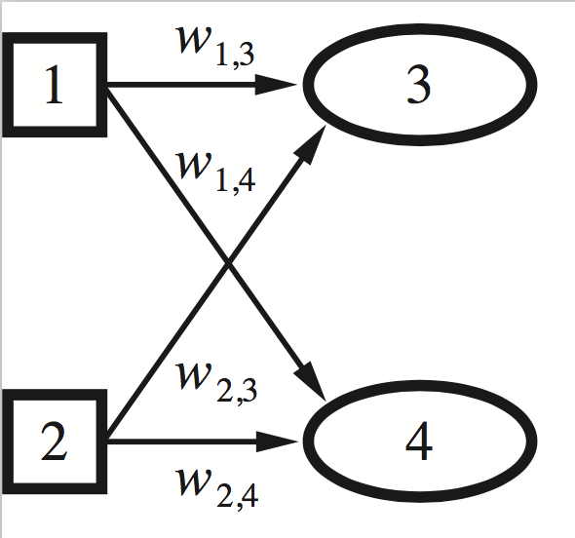
Single layer feed forward networks
One input layer (which is just the raw inputs).
One output layer (of perceptron units).
Let's design a network to add two bits together.
Needs two inputs (x₁, x₂), and two outputs (y₃, y₄).

Slide 14
Single layer feed forward networks
There is an algorithm to change the weights of a single-layer network to make the network learn any function...
Initialize starting weights randomly
Do until you want to stop (typically when accuracy is good enough or weights stop changing):
for each training example (x, y):
use NN to get prediction of h(x)
if h(x) differs from y, update all weights:
w[i] = w[i] + (y – h(x)) * x[i]
compute accuracy over entire training data = (# predicted correctly)/(# of training examples)

Slide 15
Single layer feed forward networks
There is an algorithm to change the weights of a single-layer network to make the network learn any function...
as long as it is linearly-separable!

Slide 16
Multi-layer feed forward networks
McCullough, Pitts, and Rosenblatt were all aware of the linear separability problem.
If we add another layer of units between the input and output layers, we can learn any function!
http://playground.tensorflow.org/

Slide 17
Multi-layer feed forward networks

Slide 18
Multi-layer feed forward networks
Learning is done through the backpropagation algorithm (backprop).
Derived through calculus (we will skip).

Slide 19
Review perceptron learning
Initialize starting weights randomly
Do until you want to stop (typically when accuracy is good enough or weights stop changing):
for each training example (x, y):
use NN to get prediction of h(x)
if h(x) differs from y, update all weights:
w[i] = w[i] + (y – h(x)) * x[i]
compute accuracy over entire training data = (# predicted correctly)/(# of training examples)

Slide 20
Review perceptron learning
In the perceptron learning algorithm, where did the update equation come from?
w[i] = w[i] + (y – h(x)) * x[i]
Recall h(x) = w[0] * x[0] + w[1] * x[1] + ...
If y = 1, but h(x) = 0, then h(x) is too small.
How do we increase h(x)?
Increase the weights w[0], w[1], ...
By how much?
Proportionally to their corresponding input x[i] value.

Slide 21
Review perceptron learning
Learning with a hard threshold function is rather erratic because of the binary nature of its output.
Threshold function is not differentiable (so what?)
Always outputs 0 or 1; doesn't give us gradations of predictions.
Let's switch to the logistic/sigmoid function as our activation function.

Slide 22
Review perceptron learning
How does the update equation change when our activation function is the logistic function rather than a hard threshold?
Let's look at what errors look like under the hard threshold function vs the logistic function.
Notes:
Explain gradient descent as mountain analogy. with fog.

Slide 23
Gradient descent

Slide 24
Review perceptron learning
Assuming a NN doesn't classify everything correctly, how do we measure how good or bad it is doing?
Error functions:
L1-norm loss: measure |y – h(x)|
L2-norm loss: measure (y – h(x))²
Clearly both loss functions penalize big differences more than small differences, but L1 penalizes proportionally, and L2 penalizes more harshly than L1

Slide 25
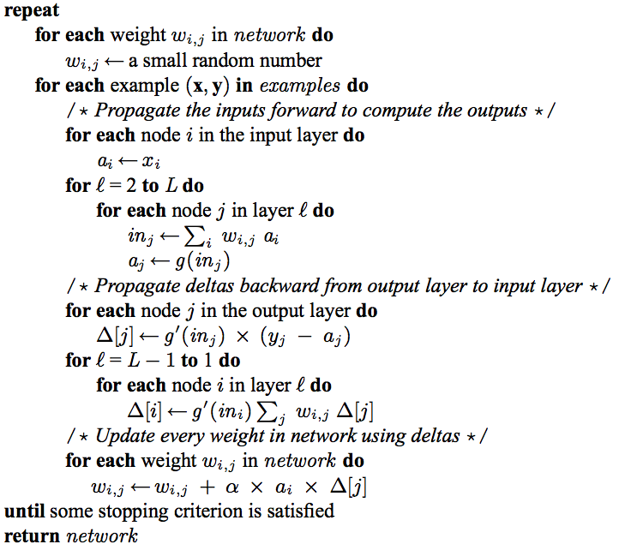
Backpropagation algorithm

Slide 26
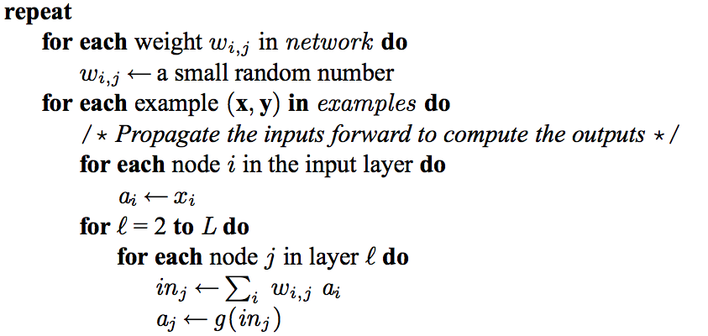
Backprop highlights

Slide 27
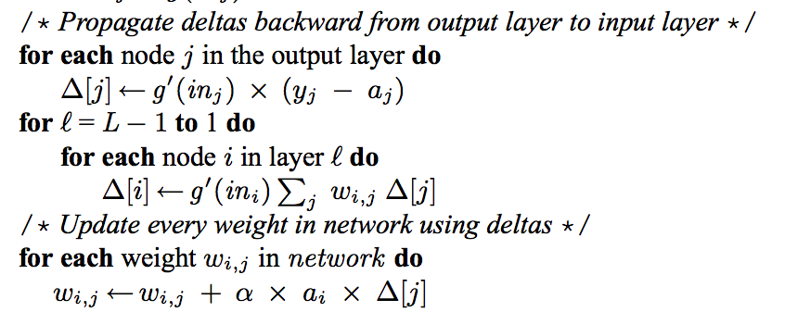
Backprop highlights

Slide 28
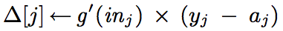
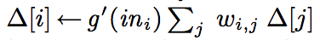

Compare
w[i] = w[i] + (y – h(x)) * x[i]

Slide 29
History
1943 – McCullough-Pitts neuron (can't be trained)
1958 – Rosenblatt's perceptron (can be trained)
1969 – Minsky and Papert publish Perceptrons, which explains the limits of single-layer NNs.
Ushers in first "AI Winter"
1982 – Backprop algorithm for NNs is published.
Was known in the 60s! AI Winter eliminated a lot of AI funding and people were discouraged from working on AI projects.
1980s – NNs rise again!
1989 – NNs are "universal approximators."

Slide 30
History
1989 – Convolutional NN used to do handwritten digit recognition for ZIP codes. (Yann LeCun)
1990s – NNs start to be seen as "painfully slow." Takes a long time to train them. At the same time, people start making more and more modifications to make NNs predict things better – adding more layers, making them recurrent etc.
Mid 90s – 2nd AI Winter occurs when everything breaks down and the community loses faith in NNs (too slow, too hard to train with backprop, don't work well, nobody understands them anyway).
Move to other models, especially probabilistic.

Slide 31
History
Winter continues through early 2000s, though some people continue working on NNs.
2006 paper: "A fast learning algorithm for deep belief nets"
Key idea – don't initialize weights randomly. Start off with a round of unsupervised learning to find reasonable initial values for the weights, then finish with regular supervised learning.
2nd key idea – pure computational power of GPUs.
Massively parallel! 70x faster than training on CPUs.
3rd key idea – huge data sets.

Slide 32
History
2010 – Turns out the activation function used makes a huge difference on training time and performance.
Notes:
rectified linear unit

Slide 33
Lessons
Our labeled datasets were thousands of times too small.
Our computers were millions of times too slow.
We initialized the weights in a stupid way.
We used the wrong type of non-linearity.

